Slide 1
Collaborative Filtering By Yaohang Li, Ph.D. Department of Computer Science Old Dominion University
Some slides and figures are adopted from Karatzoglou

Slide 2
Paradigms of recommender systems
Approaches
Collaborative Filtering
Content-based Filtering
Context-aware Recommendation
Other Approaches
Knowledge-Based Recommendations
Hybrid Recommender Systems
In most applications, the most effective approach is collaborative filtering
Other approaches can be combined to improve results

Slide 3
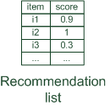

Paradigms of recommender systems
Recommender systems reduce information overload by estimating relevance

Slide 4


Paradigms of recommender systems
Personalized recommendations

Slide 5

Paradigms of recommender systems
Collaborative: "Tell me what's popular among my peers"

Slide 6

Paradigms of recommender systems
Content-based: "Show me more of the same what I've liked"

Slide 7


Paradigms of recommender systems
Knowledge-based: "Tell me what fits based on my needs"

Slide 8
Paradigms of recommender systems
Hybrid: combinations of various inputs and/or composition of different mechanism

Slide 9
Challenges
Data Preprocessing
Outlier removal
Denoising
Removal of global effects
Dimensionality Reduction
Linear
Non-linear
Combining Different Methods

Slide 10
Purpose and success criteria (1)
Different perspectives/aspects
Depends on domain and purpose
No holistic evaluation scenario exists
Retrieval perspective
Reduce search costs
Provide "correct" proposals
Users know in advance what they want
Recommendation perspective
Serendipity – identify items from the Long Tail
Users did not know about existence
Notes:
Could a RS be a persuasive technology? In fact depending on the application area RS are deployed to:

Slide 11
Purpose and success criteria (2)
Prediction perspective
Predict to what degree users like an item
Most popular evaluation scenario in research
Interaction perspective
Give users a "good feeling"
Educate users about the product domain
Convince/persuade users - explain
Finally, conversion perspective
Commercial situations
Increase "hit", "clickthrough", "lookers to bookers" rates
Optimize sales margins and profit

Slide 12
Collaborative Filtering
The task of predicting (filtering) user preferences on new items by collecting favorability information from many users (collaborative)
Challenges
Many items to choose from
Very few recommendations to propose
Usually only a few items per user
Very large datasets

Slide 13
Classes of Collaborative Filtering
Memory-based Collaborative Filtering
User-based Collaborative Filtering
Item-based Collaborative Filtering
Model-based Collaborative Filtering

Slide 14
An Example
Each user has expressed certain opinion for some items
Explicit opinions:
Rating
Like
Implicit opinions
Purchase records
Click
Browse
Download
Etc.

Slide 15
Example: User-based Collaborative Filtering
Target user for whom the recommendation task is performed

Slide 16
Example: User-based Collaborative Filtering
Identify a set of items rated by the target user

Slide 17
Example: User-based Collaborative Filtering
Obtaining neighborhood information
Identify a set of users rated 1+ items in this set

Slide 18
Example: User-based Collaborative Filtering
User-based Similarity
Similarity function
Compute how similar each neighbor is to the target user
Typically, k-nearest neighbors are selected

Slide 19
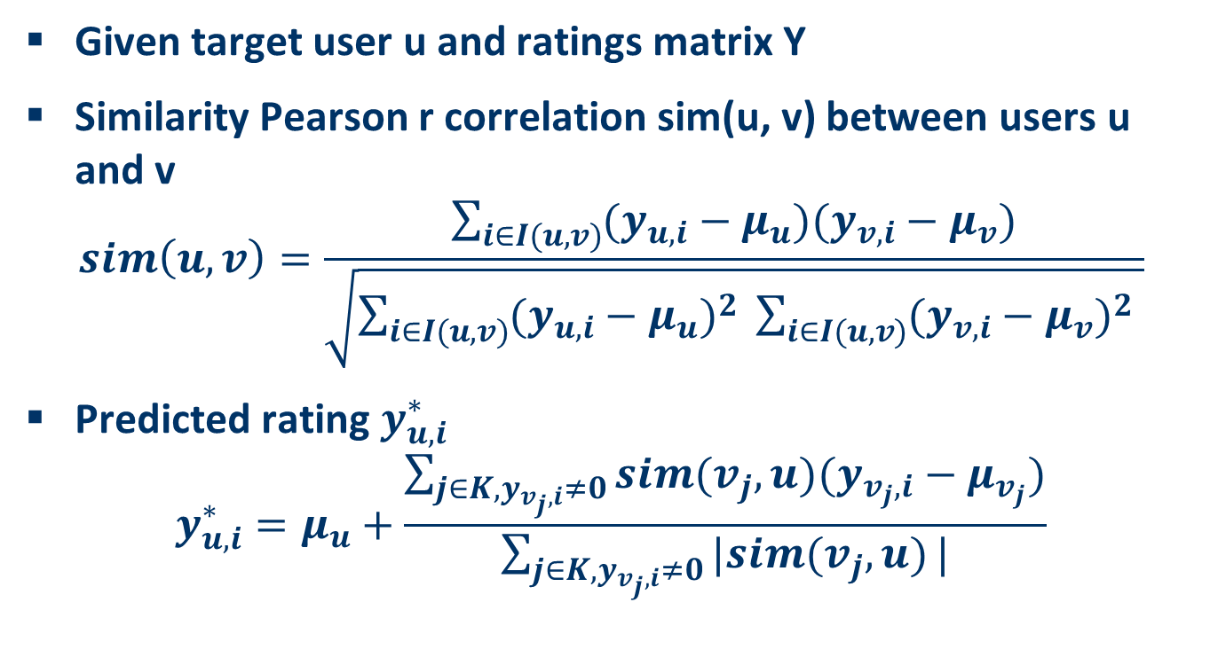
Similarity Function
Given target user u and ratings matrix Y
Similarity Pearson r correlation sim(u, v) between users u and v
$$sim\left(u,v\right)=\frac{\sum_{i∈I(u,v)}{(y_{u,i}−μ_{u})(y_{v,i}−μ_{v})}}{\sqrt{\sum_{i∈I(u,v)}{{(y_{u,i}−μ_{u})}^{2} }\sum_{i∈I(u,v)}{{(y_{v,i}−μ_{v})}^{2} }}}$$
Predicted rating $y_{u,i}^{∗}$
$$y_{u,i}^{∗}=μ_{u}+\frac{\sum_{j∈K,y_{v_{j},i}≠0}{sim(v_{j},u)(y_{v_{j},i}−μ_{v_{j}})}}{\sum_{j∈K,y_{v_{j},i}≠0}{|sim(v_{j},u)}|}$$

Slide 20
Example: User-based Collaborative Filtering

Slide 21
Example: User-based Collaborative Filtering

Slide 22
Example: User-based Collaborative Filtering

Slide 23
Example: User-based Collaborative Filtering

Slide 24
Example: Item-based Collaborative Filtering
Target item

Slide 25
Item-based Collaborative Filtering
The basic steps:
Identify a set of users who rated the target item i
Identify which other items (neighbors) are rated by this user set
Compute similarity between each neighbor and target (similarity function)
Predict ratings for the target item (prediction)

Slide 26
Item-based Similarity

Slide 27
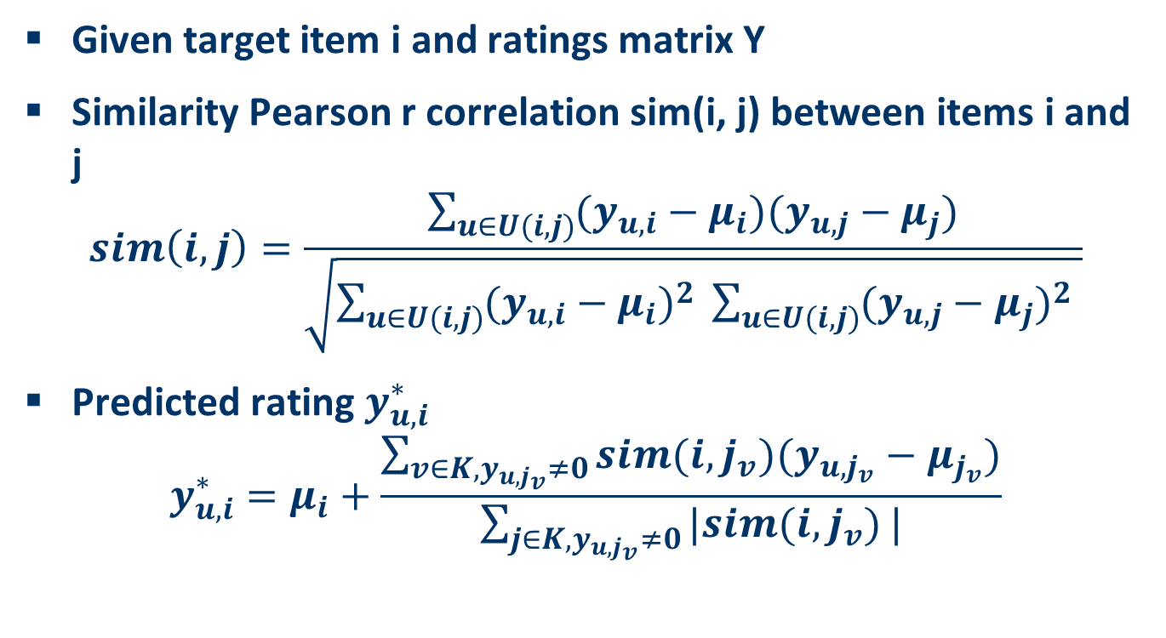
Similarity Function
Given target item i and ratings matrix Y
Similarity Pearson r correlation sim(i, j) between items i and j
$$sim\left(i,j\right)=\frac{\sum_{u∈U(i,j)}{(y_{u,i}−μ_{i})(y_{u,j}−μ_{j})}}{\sqrt{\sum_{u∈U(i,j)}{{(y_{u,i}−μ_{i})}^{2} }\sum_{u∈U(i,j)}{{(y_{u,j}−μ_{j})}^{2} }}}$$
Predicted rating $y_{u,i}^{∗}$
$$y_{u,i}^{∗}=μ_{i}+\frac{\sum_{v∈K,y_{{u, j}_{v}}≠0}{sim(i,j_{v})(y_{{u,j}_{v}}−μ_{j_{v}})}}{\sum_{j∈K,y_{{u, j}_{v}}≠0}{|sim(i, j_{v})}|}$$

Slide 28
Example: Item-based Collaborative Filtering

Slide 29
Example: Item-based Collaborative Filtering

Slide 30
Example: Item-based Collaborative Filtering

Slide 31
Example: Item-based Collaborative Filtering

Slide 32
Item-based Prediction

Slide 33
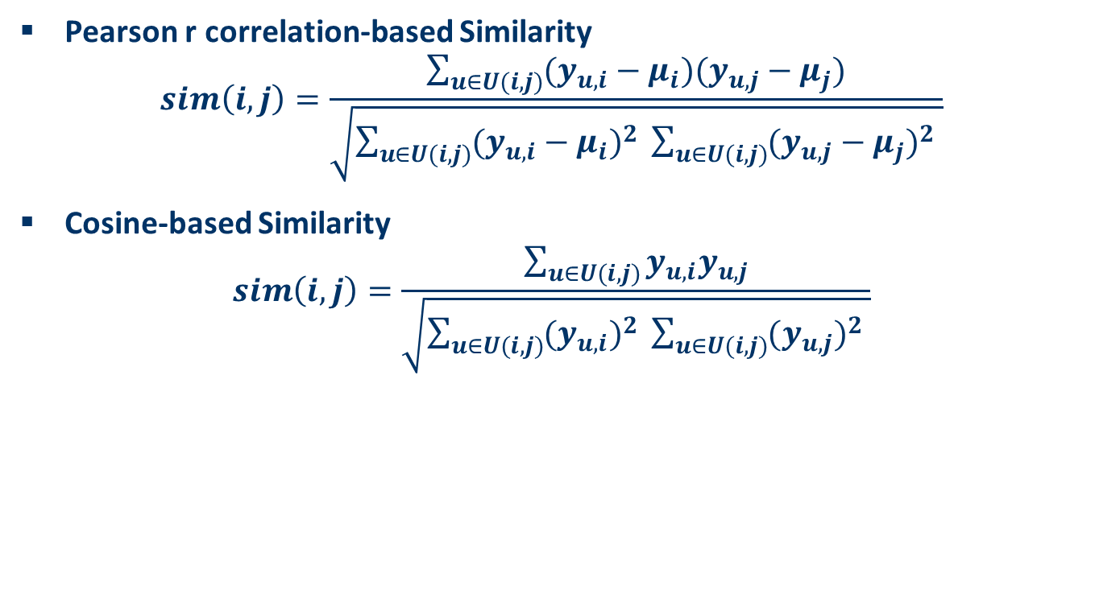
Item Similarity Computation
Pearson r correlation-based Similarity
$$sim\left(i,j\right)=\frac{\sum_{u∈U(i,j)}{(y_{u,i}−μ_{i})(y_{u,j}−μ_{j})}}{\sqrt{\sum_{u∈U(i,j)}{{(y_{u,i}−μ_{i})}^{2} }\sum_{u∈U(i,j)}{{(y_{u,j}−μ_{j})}^{2} }}}$$
Cosine-based Similarity
$$sim\left(i,j\right)=\frac{\sum_{u∈U(i,j)}{y_{u,i}y_{u,j}}}{\sqrt{\sum_{u∈U(i,j)}{{(y_{u,i})}^{2} }\sum_{u∈U(i,j)}{{(y_{u,j})}^{2} }}}$$

Slide 34
Performance Implications
Similarity computation is the big bottleneck
Time complexity, highly time consuming with millions of users and items in the database
Two-step Process:
Off-line component:
Similarity computation
Precalculated and Stored
Online component:
Prediction Process

Slide 35
Two-Step Process

Slide 36
User-based CF vs Item-based CF
User-based similarity is more dynamic
Precomputing user neighborhood can lead to poor prediction
Item-based similarity is more static
Item neighborhood can be reliably precomputed
The ratings can be computed online

Slide 37
Personalized vs. non-Personalized CF
Personalized Collaborative Filtering
The prediction is based on the ratings from similar (neighboring users)
Each target user has different set of neighbors
Non-personalized Collaborative Filtering
E.G. Generating recommendations by averaging the recommendations of all users

Slide 38
The Sparsity Problem
The Sparsity Problem
Large product sets
Few user ratings
Given a catalog with 1 million items, the probability that two users who bought 100 books each, has one book in common is 0.01
Given a catalog with 10 million items, the probability that two users who bought 100 books each, has one book in common is 0.0001
Rule of thumb
The number of users at least 10% of the product catalogue size

Slide 39
The Sparsity Problem
Methods for Dimensionality Reduction
Clustering
Matrix Factorization

Slide 40
Model Based CF
Models are learned from the underlying data rather than heuristics
Deterministic Approaches
Clustering
Association Rules
Matrix Factorization
Restricted Boltzmann Machines
Probabilistic Approaches
Bayesian network
Probabilistic latent semantic analysis

Slide 41
Clustering
Cluster customers into categories based on past preferences
Compute recommendation at the cluster level
All customers within a cluster receive the same recommendations

Slide 42
Clustering Example
B, C, D form Cluster 1
A, E form Cluster 2
Typical preferences for Cluster 1 are
Book 2, very high
Book 3, high
Books 5, 6, maybe
Books 1, 4, no

Slide 43
Analysis of Clustering
Faster recommendations
Recommendation for the whole cluster
Less personalized
Recommendation per cluster vs. recommendation per user

Slide 44
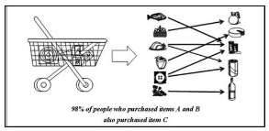
Association Rules
Past purchases used to find relationships of common purchases
Each transaction for association rule is the set of items bought by a particular user
Finding item association rules
Buy_X -> Buy_Y
Rank items based on measure such as confidence
Freq(Buy_X, Buy_Y)/Freq(Buy, X)

Slide 45
Analysis of Association Rules
Advantages
Fast to implement
Fast to execute
Not much storage space required
Very successful in broad applications, such as shelf layout in grocery stores
Disadvantages
Not suitable if preferences change rapidly
Rules can be applied only when sufficient data to support them
False associations can arise

Slide 46
Matrix Factorization

Slide 47
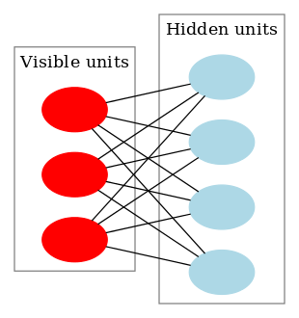
Restricted Boltzmann Machines
A Generative Stochastic Neural Network
Learns a probability distribution over its inputs
Used in dimensionality reduction, collaborative filtering, feature selection
Essential components of deep learning methods

Slide 48
Restricted Boltzmann Machine for CF
Each unit in the visible layer v_{i} corresponds to one item
The number of the hidden units h_{j} is a parameter.
Each vi is connected to each h_{j} through a weight w_{ij}

Slide 49
Training of Restricted Boltzmann Machine
In the training phase, for each user:
if the user purchased the item the corresponding vi is activated.
The activation states of all vi are the input of each hj
Based on this input the activation state of each hj is calculated
The activation state of all hj become now the input of each vi
The activation state of each vi is recalculated
For each vi the difference between the present activation state
and the previous is used to update the weights wij

Slide 50
Prediction using Restricted Boltzmann Machine
In the prediction phase, using a trained RBM, when recommending to a user:
For the items of the user the corresponding vi is activated.
The activation states of all v are the input of each hj
Based on this input the activation state of each hj is calculated
The activation state of all hj become now the input of each vi
The activation state of each vi is recalculated
The activation probabilities are used to recommend items

Slide 51
Limitation of Collaborative Filtering
Requires User-Item data:
It needs to have enough users in the system.
New items need to get enough ratings.
New users need to provide enough ratings (cold start)
Sparsity:
it is hard to find users who rated the same items.
Popularity Bias:
Cannot recommend items to users with unique tastes.
Tends to recommend popular items.

Slide 52
Cold Start Problem
New User Problem: the system must first learn the
user’s preferences from the ratings
hybrid RS, which combines content-based and collaborative techniques, can help
New Item Problem: Until the new item is rated by
a substantial number of users, the RS is not able to recommend it

